Slide 1
ECE470 Genetic Algorithm Project
By Cameron Gregory, Daniel Nguyen, and Jake Vidal

Slide 2
Feature Selection for Classification
Problem Statement
Motivation
Our approach
Encoding the problem
Fitness function
Results and comparison
Code demonstration
Questions

Slide 3
Problem Statement
Large datasets with a significant number of features are very difficult to classify accurately due to the curse of dimensionality

Slide 4
Motivation
Our goal is to create an approach that will allow more accurate classification for datasets with many features
This is important as businesses and organizations collect large amounts of data which must be accurately classified in order to guide decisions
The genetic algorithm is used in order to find a subset of the features that reaches the best classification accuracy while also maintaining the original features

Slide 5
Encoding the problem
Feature 1
Feature 2
Feature 3
Feature 4
1 0 1 1
The chromosomes, optimized by our genetic algorithm, each represent a subset of the list of features in the dataset
Each gene in the chromosome corresponds to a specific feature and can hold the value of 0 or 1 denoting whether a feature should be used in classification

Slide 6
Our approach
First an initial population of chromosomes is generated
Next, subsets of our original dataset are generated by removing features as defined by the chromosomes
The altered datasets are then run through a classifier in order to test the classification accuracy when using the subset of the features defined by each chromosome
The chromosomes are then ordered based on fitness and chosen for breeding based on a raffle, where a higher fitness leads to more tickets in the raffle

Slide 7
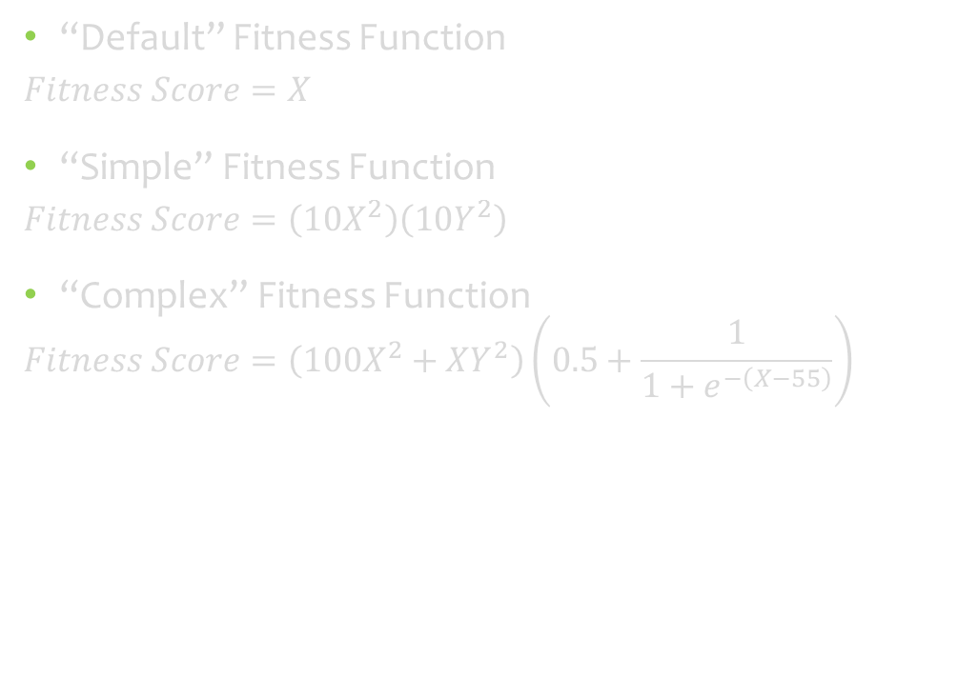
Defining our fitness function
Fitness scoring is based on accuracy and number of features removed from the dataset
Through experimentation, multiple fitness functions have been generated
X = Percent accuracy from 0 to 100%
Y = Percent features removed from 0 to 100%
“Default” Fitness Function
$$Fitness Score=X$$
“Simple” Fitness Function
$$Fitness Score=\left(10X^{2}\right)\left(10Y^{2}\right)$$
“Complex” Fitness Function
$$Fitness Score=\left(100X^{2}+XY^{2}\right)\left(0.5+\frac{1}{1+e^{−\left(X−55\right)}}\right)$$

Slide 8
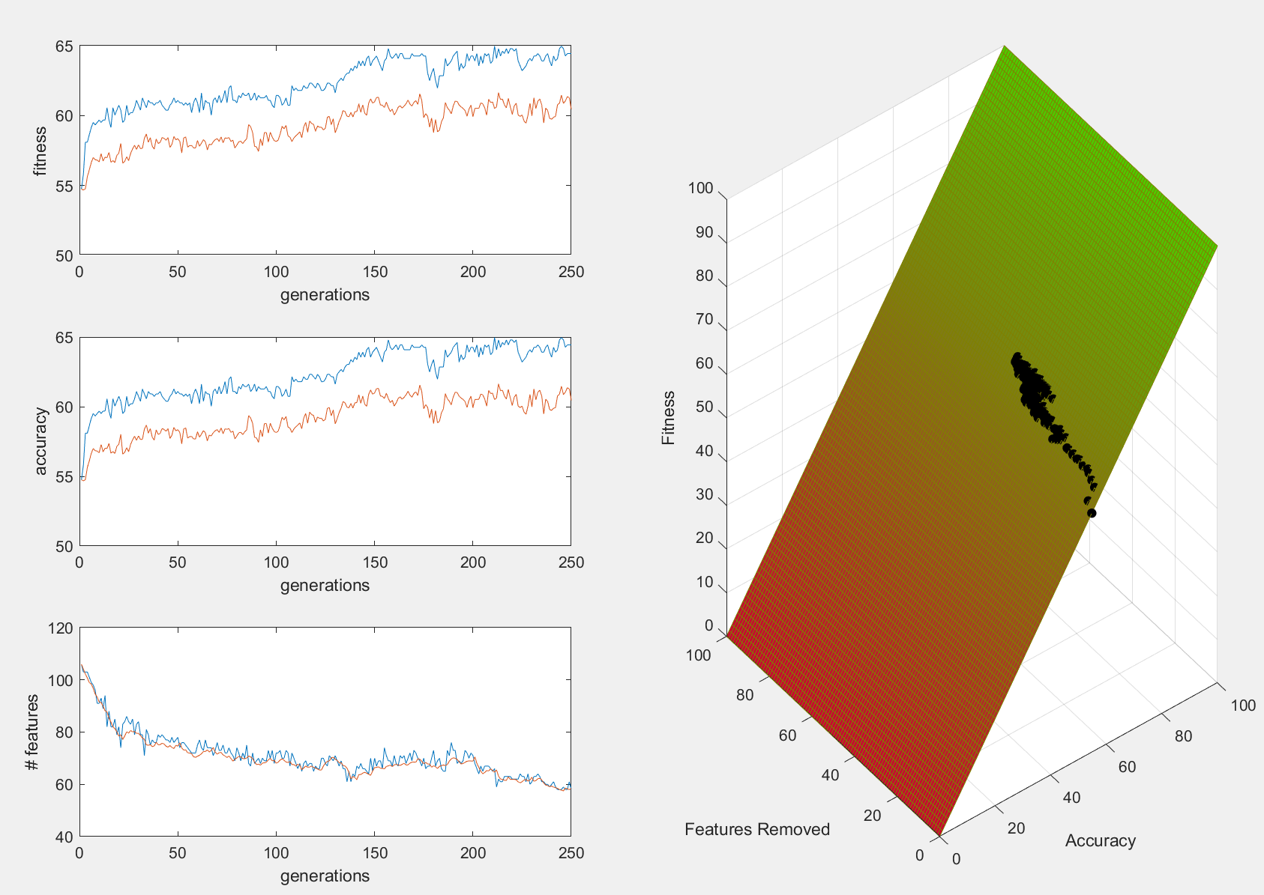
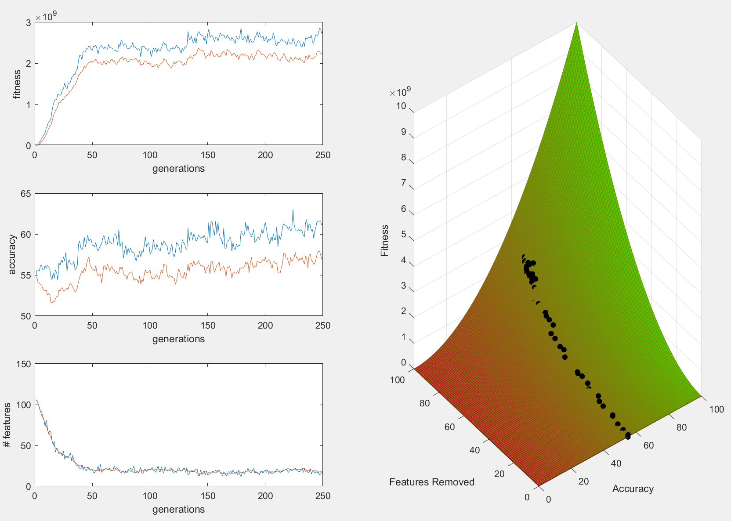
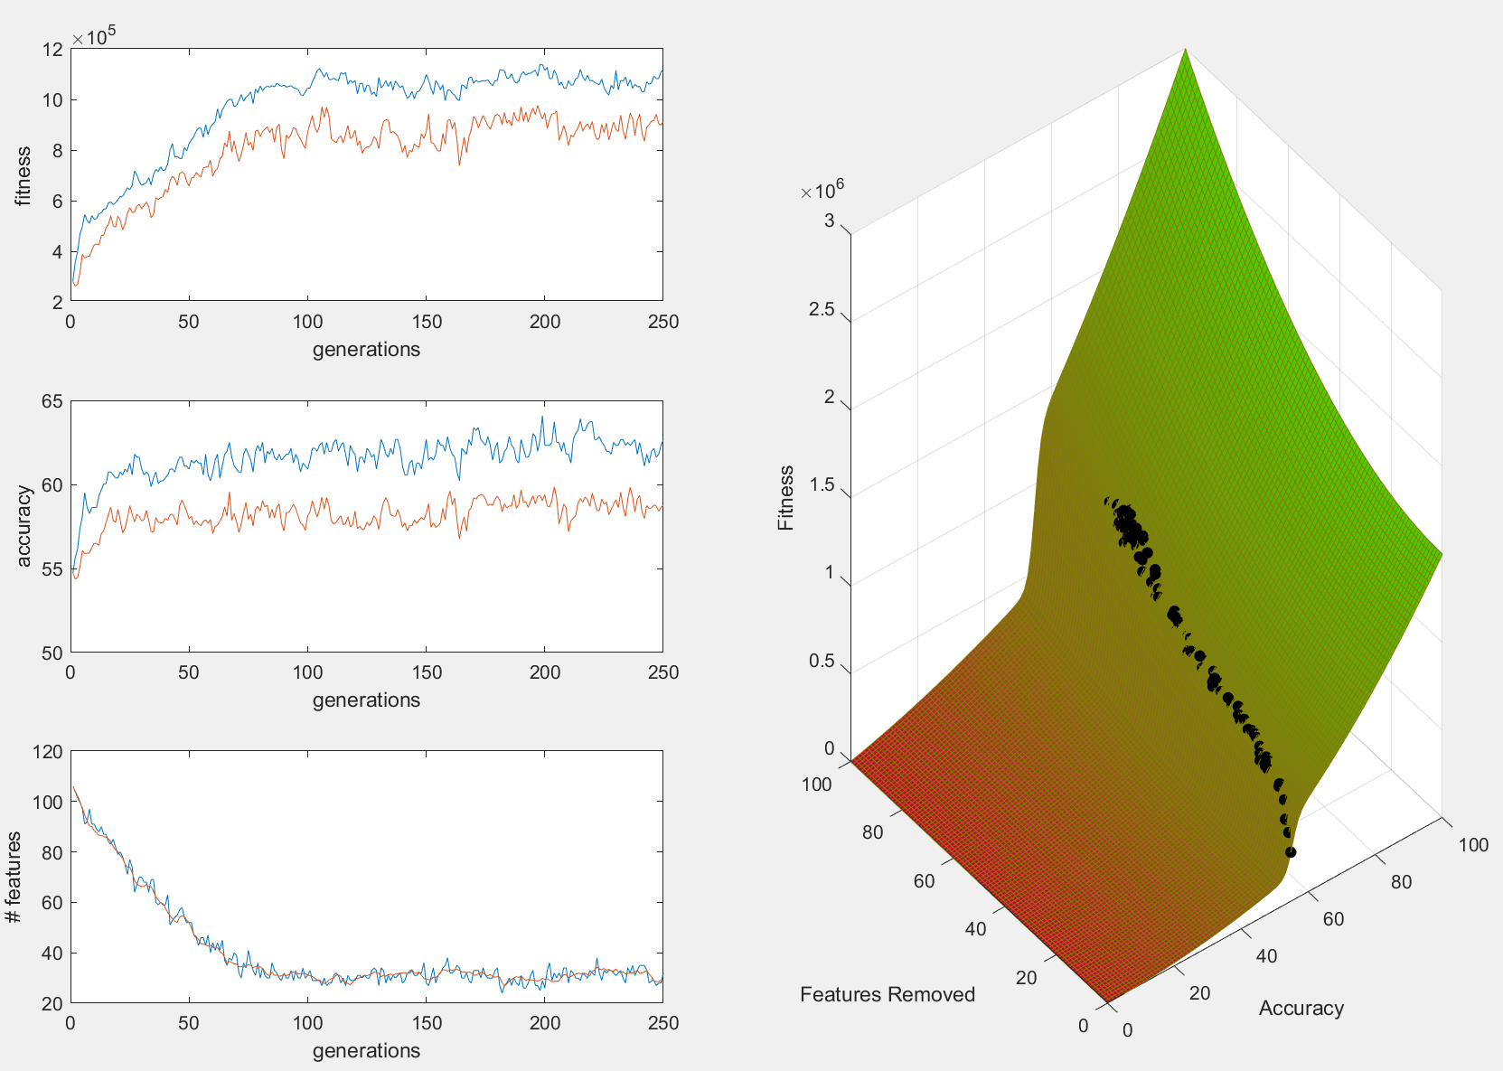
Results and comparison
“Default” Fitness Function
“Simple” Fitness Function
“Complex” Fitness Function

